Slide 1
Foreign Exchange Markets
Spot and Forward markets, hedging, and exchange rate determination

Slide 2
Learning Objectives
What is the foreign exchange market and what are reasons for its growth?
Who participates in the foreign exchange market and why?
What is the difference between the spot and forward markets (and rates)?
How does hedging reduce exchange risk?
What factors determine exchange rate prices and changes in rates?
What are speculation and arbitrage and what are different forms of arbitrage?

Slide 3
The Foreign Exchange (Forex) Market
What is the Forex?
  Collection of all entities whose purpose is the exchange of national currencies
  Typically conducted through the “international desk” of major banks
Notes:
Central banks in each country (Federal Reserve)
Large banks around world managing exchange rates

Slide 4
Who participates in Forex markets?
Commercial Customers
  transactions related to trade & investment
Governments
  stabilize currency (theirs or others/small & large)
  influence exchange rates
Speculators
  ‘bet’ on currency movements
Arbitrageurs
  exploit price differences in markets
Notes:
Must purchase currency of seller in order to make purchase

Slide 5
Forex growth
Huge increase in level of DAILY activity
1986 -2014 ($200 billion - 6 Trillion), falling since
  Increased international commerce
  Deregulation
  Technology – ease and cost
  Increased volatility in markets
  (reduce risk/gain opportunity)
  Decline since 2014 – lower levels of trade/FDI
Notes:
NOTE: This is from the BIS 2013 survey – which is done only every 3 years.
FT reports slump at end of 2013 – attributed to trading scandals http://www.ft.com/cms/s/0/f20f4284-77a3-11e3-afc5-00144feabdc0.html#axzz2yCMXoDf3 (23% drop from Dec 2012).
This was up from $4 trillion in 2010 and $3.3 tril`lion in 2007. The US dollar was the dominant currency: 87% of deals contained the dollar on one side. The euro, the second-most-traded currency, was involved in 33% of deals, down from 39% in April 2010. The third-most-traded currency, featuring in 23% of all trades, was the Japanese yen; its market share has risen by four percentage points since the previous survey. Several emerging-market currencies rose sharply in global importance. The Mexican peso and Chinese renminbi made it into the top ten for the first time.
Note that Forex decreased in post 2001 period due to 9/11 contraction and Euro: SOME SAY LEVEL IS $1900 BILLION now!!!
Whys are: “deregulation”, growth of trade/FDI, more floating currencies, more volatility, more speculation/arbitrage due to knowledge and technology.

Slide 6
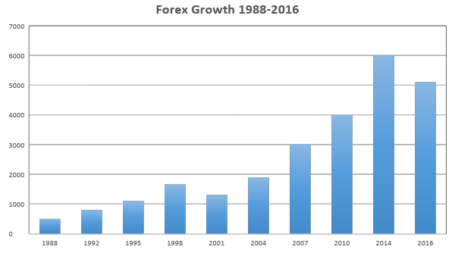
Growth in Forex
* Note: decrease 2001–2003 (and by over 25% in 2008–2009)
Notes:
Note – these numbers may be exaggerated. Details are:
This $3.21 trillion in global foreign exchange market "traditional" turnover was broken down as follows:
$1,005 billion in spot transactions
$362 billion in outright forwards
$1,714 billion in forex swaps
$129 billion estimated gaps in reporting

Slide 7
Active Markets Exist for Few Currencies
Dollar, Euro, Pound, Yen
Difficult to do a major transaction from (i.e.) lira to won
Traders in other currencies first convert into one of the main currencies
Role of the Dollar
  ≈ 87% of cross-currency trades (down from 90%)
  Major “reserve” currency for governments and commercial entities (60% of global reserves)
NOTE: Some currencies not available in foreign exchange market (non-convertible) – typically due to nations’ policies regarding currency exchanges/rates
  Implication?
Notes:
Note that reserve currency status makes prediction of dollar value doubly difficult and makes it difficult for US policy to impact trade deficit – pool of currency at large is so large… also most nations/banks/investors have a stake in what happens to the $ (it’s their OWN asset pool!).
Note use of countertrade with non-convertible currencies

Slide 8


Commercial FX
lira
won
Lira $
$ Won

Slide 9
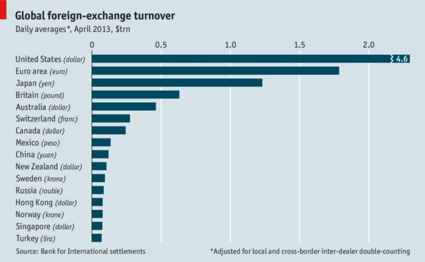
Forex daily volume

Slide 10
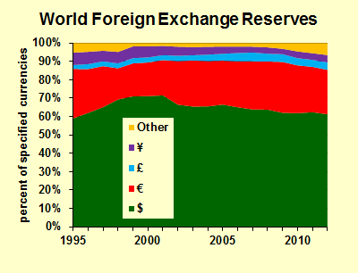
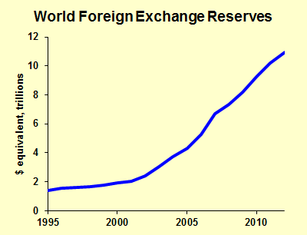
Dollar reserves

Slide 11
Spot Market
Market to buy or sell currency NOW
Rate is “SPOT rate”
33% of forex transactions… (excluding forex swaps* )
Most volatile because related to passive FDI/speculation
*A “swap” is a currency exchange at two different future periods
Notes:
Forex swaps will be explained later: used to create a hedge or with interest rate arbitrate and/or speculation

Slide 12
Spot market doesn’t fit needs of commercial interests:
What if firm does something today that will require foreign currency at a future time?
(i.e., an agreement to purchase goods for future delivery or a decision to purchase/invest in a foreign company)
What would be effect of a change in currency exchange rates?
Foreign exchange “exposure” (transaction exposure)

Slide 13
Example of Risk
US importer buys ball bearings from a German producer, Price = €870,000 payable upon delivery in 90 days
Suppose the exchange rate is $1 = €0.87 (1.15 $/€)
$ cost of purchase = $1,000,000
Suppose spot rate changes to €0.85 /$ (Euro appreciates/ revalues)…
new $ cost in 90 days = $1,023,529
US importer must pay $23,529 more than planned
Notes:
NOTE: Capital market example is at end… cut due to lack of time. Note terminology… revalue vs appreciate

Slide 14
Example of Risk
US importer buys ball bearings from a German producer, Price = € 870,000 payable upon delivery in 90 days
Suppose the exchange rate is $1 = €0.87 (1.15 $/€)
$ cost of purchase = $1,000,000
If rate changes to €0.89 /$ (Euro depreciates/ devalues)
new $ cost = $977,528
US importer “saves” $22,472

Slide 15
How to deal with this risk:
Accept risk, take the chance
  companies prefer not to speculate
Buy currency (Euro/dollars) at time of initial transaction
  ties up working capital
  ANSWER: Use the FORWARD MARKET to eliminate risk:
…HEDGING

Slide 16
Forward Market (Futures and Options)
Contract NOW to buy/sell foreign currency at future date… (actual rate set now – but money exchanged later)
Used to mitigate risk (and with speculation and arbitrage)
66% of forex transactions (excluding swaps)

Slide 17
Forward Market – Two forms: Futures and Options
Future: A PROMISE to buy/sell currency at given price at a future date (30, 90, 180 days standard – though any length possible)
Option/choice to buy or sell as above - but not an obligation
Rate is FORWARD rate (typical rate quote is for a FUTURE… Options cost more)
(e.g., to buy €870,000 in 90 days at $1 = €.87)
Notes:
http://www.fxstreet.com/rates-charts/forward-rates/
Currency option is a financial instrument that gives the holder the right (but not the obligation):
* To sell which is known the put option or
* To buy which is known as the call option
* A specified quantity of a contracted currency,
* At a set price (called the strike price) and expiration date
The privilege so derived by the buyer of the option is offset by a consideration paid to the seller. This consideration is called the option premium.
The booming growth in the financial instruments market resulted in the introduction of currency futures options. These instruments permit purchases and sales of put and call options of futures contracts in a currency.

Slide 18
Hedging - trade
Buying currency in the forward market to eliminate uncertainly (risk) in currency value
  US importer buys ball bearings from a German producer, Price = €870,000 payable in Euros upon delivery in 90 days
  Buy €870,000 in Forward market for 0.85 €/$: Cost is $1,023,529 whether dollar appreciates or depreciates

Slide 19
Hedging example
  US importer buys ball bearings from a German producer, Price = €870,000 payable in Euros upon delivery in 90 days
  Buy €870,000 in Forward market for 0.85 €/$: Cost is $1,023,529 whether dollar appreciates or depreciates
  T1: Makes deal AND buys Euros in Forward Market
  T2: Pays for Euros AND goods
T1
90 days
T2

Slide 20
Normally there is a difference between Spot and Forward rates…
Can be selling at discount or premium
Caused by interest rate differences, and/or inflation rates, trade patterns, etc.
Determined by expectations about currency movements
Eurocurrency rates
Notes:
Eurocurrency: a currency that is held in a bank that is not in the country of that currency

Slide 21
Calculation of ANNUALIZED Premium or Discount (forward rate):
Comparing rates for different periods is confusing
P(s) - P(f)
  P(s)
  where:
  P(s) = spot price
  P(f) = forward price
  n = # periods in a year
  Expressed as a percentage
x n
Notes:
DON’T FORGET N (Periods in year)

Slide 22
If spot is $= € 0.87, & 90-day forward rate is $= € 0.89 :
Example 1
P(s) - P(f)
  P(s)
  P(s) = 0.87 P(f) = 0.89 n = 4 (4 90-day periods/year)
0.87 – 0.89
  0.87
  Euro is Selling at an 9.2% discount
x n
= -.023 x 4 = -.092
-9.2%

Slide 23
If spot is $= € 0.87, & 180-day forward rate is $= € 0.84 :
Example 2
P(s) - P(f)
  P(s)
  P(s) = 0.8 P(f) = 0.84 7 n = 2
0.87 – 0.84
  0.87
  Euro is Selling at an 6.8% premium
x n
= .034 x 2 = 0.068
= 6.8%

Slide 24
What determines exchange rate levels?
Price differences
  PPP (relationship between prices and exchange rate)
  Economic changes
  Money supply – inflation
  Interest rates
Market psychology/expectations

Slide 25
What determines exchange rate levels?
Price differences:
a) Purchasing Power Parity (PPP)
How much does your money “buy” in different places?
THEORETICALLY… it should be the same anywhere
  Goods sold in different locations should have the same “price” (Law of One Price)… (regardless of what currency is used to “pay”)
  If price differential exists, trade will create currency adjustments

Slide 26
PPP trade effect
Suppose a Caterpillar “earth mover” cost $250,000 in the US
If the $/€ rate is $1 = €.90, the equipment should cost €225,000 in Germany
Suppose the price in Germany is
€250,000
What will happen?

Slide 27
PPP trade effect
Theoretically…
Germans will buy earth-mover in US
They will use Euros to buy Dollars
Dollar appreciates in value relative to Euro - the Euro depreciates relative to the Dollar (e.g., $1 = €0.95)
Assuming no change in product price in Germany, trend will continue until exchange rates reach parity ($1 = €1)

Slide 28
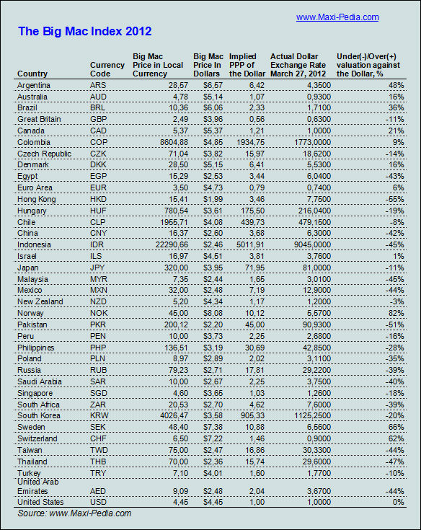
Big Mac Index 2012 –
The Economist
Notes:
The dollar price and the price in the local currency is used to determine the PPP exchange rate. Difference between PPP forex and actual forex is divided by actual rate to get over or under value (EXCEPT FOR GREAT BRITIAN AND EURO WHERE PPP IS USED TO DIVIDE B/C REFERENCE POINT IS REVERSED)

Slide 29
PPP effect
Big Mac Index
Assumes no transportation costs, no trade barriers, no intervention, perfect information, rationality, etc.
highly unrealistic
Also, trade involves many products & complex markets
PPP is not a good predictor of short-run exchange rate movements
Explains fundamental relationships
Can be useful for country comparisons in standards of living and growth

Slide 30
What determines exchange rate levels?
Price differences
b) Money supply – inflation
  If a country increases its money supply, prices will inflate (QE2 effect on US Dollar)
  Inflation causes price increase, but there is no increase in “value” (from buyers perspective), so foreign demand falls
  Reduced exports reduces demand for domestic currency and so the currency depreciates
  Thus, relative inflation rate levels and trends can be used to predict relative exchange rate movements

Slide 31
What determines exchange rate levels?
Price differences
  c) Interest rates
  Interest rates reflect expected rates of inflation
  Fisher Effect: i = r + I
    i : “nominal” (prime) interest rate in a country
    r: “real” interest rate (charged by lender)
    I : inflation over the loan period of the funds (expressed as negative)
  International Fisher Effect: (S₁-S₂)/S₂ X 100 = i_{a} - i_{b}
    S₁: spot rate at time 1, S₂ : spot rate at time 2;
    i_{a} & i_{b} = nominal interest rates in the two countries
    the spot exchange rate should change an equal % (but in the opposite direction) to the difference in nominal interest rates between the two countries

Slide 32
International Fisher Effect
Suppose US nominal interest rate is 6% while the nominal rate in Europe is 4%
What would we expect to happen to the exchange rate over time if nominal rates stay the same? ….
$ SHOULD devalue (depreciate) by 2% relative to the €
WHY?
Because interest rates express an expectation of inflation
BUT… Short-term vs. Long-term effects are different

Slide 33
What determines exchange rate levels?
Investor expectations - “Bandwagon Effect”
How to predict?
Efficient markets – don’t predict, read market
Inefficient markets – better ways to predict
Forecasting
  Fundamental analysis
  Technical analysis

Slide 34
Speculation and Arbitrage
Speculation: betting on currency rate movements. Speculators buy currencies and hold or buy or sell futures and options (buying and selling short)
Arbitrage: exploiting differences in markets
  Exchange arbitrage: exploiting differences between exchange rates in different locations
  Interest rate arbitrage: exploiting difference between interest rates in different locations based on spot rate and forward rate differences

Slide 35
Speculation Example
Spot rate: $1 = 0.82 €
90 day forward rate: $1 = 0.80 €
Suppose you think this is WRONG… you think that the dollar will not decline as much as forward rate predicts (i.e., $1 = .81 €) …
or even that the dollar will appreciate (i.e., $1 = .83 €)
How can you capitalize on this?

Slide 36
What to do? - Speculation
Plan to buy euros at spot rate in 90 days and sell them at forward rate (same date)
Make a forward contract to SELL 800,000 € at 0.80 €/$ (guaranteed to sell for $100,000,000)
IF you are right you can make a profit:
Example 1: If spot rate 90 days in future is $1 = 0.81 €, it will cost $987,654 to buy 800,000 €, but after selling Euros with your forward contract for $1,000,000… EARNINGS $12,346
Example 2: If spot rate 90 days in future is $1 = 0.83 €, it will cost $963,855 to buy 800,000 €, but after selling Euros with your forward contract for $1,000,000… EARNINGS $36,145
BUT… IF you are wrong, you will have to buy MORE expensive Euros to settle forward contract

Slide 37
Exchange Arbitrage
Buy currency in one mkt to immediately sell in other market(s)
Purpose: riskless profit from currency price (rate) differences in different markets
Effect: Equalizes currency prices worldwide

Slide 38
2-Point Ex. Arbitrage
Currency prices different in two markets; e.g.,
  New York: $ = €0.89
  Frankfurt: $ = €0.90
$ “cheap” in NY in € (relative to Frankfurt)
€ “cheap” in Frankfurt in $ (relative to NY)
How to make risk-free profit?
BUY LOW/SELL HIGH

Slide 39
...simultaneously buy € in Frankfurt, sell them in NY
Frankfurt: Buy €900,000 for $1,000,000 (at $1 = €0.90)
NY: Sell €900,000 for $1,011,236 (at $1 = €0.89)
Profit = $11,236 (risk free)
Effect: € demand in Frankfurt ( price);
€ supply NY ( price)

Slide 40
... or buy $ in NY and sell them in Frankfurt
NY: Buy $1,123,595 w/ €1,000,000 (at $1 = €0.89)
Frkft: Sell $1,123,595 for 1,011,235€ (at $1 = €0.90)
Profit = €11,235 (risk free)
Effect: $ demand in NY ( price); $ supply in Frankfurt ( price)
(Note that you can “start” with either currency the only difference would be whether the gain is realized in $ or €)
Notes:
Blue “note” at bottom has been added and next slide from the original set is not here

Slide 41
Interest Arbitrage (Carry Trade)
Investors/borrowers exploit interest rate differences while avoiding exchange risk
NOTE: Can occur when there are discontinuities between the “forward rate” between two currencies and the nominal interest rates in those countries.
...via forward exchange market
Highest volume type of arbitrage

Slide 42
Example:
Rate for 90-day funds is 8% in NY, and 12% in London
Can a US investor capitalize on higher rates in London, yet avoid exchange risk?
Solution: (Hedge the investment)
  buy £ to invest in London @12%
  at the same time, sell £ 90 days forward at the forward rate (to redeem £ invested)
  eliminates exchange risk
Notes:
Note – normal arbitrage is to exploit via borrowing… SO borrow money in NY first – but then exchange rate must compensate for interest rate to be paid.

Slide 43
Example:
Rate for 90-day funds is 8% in NY, and 12% in London
Spot rate: £ =$1.65
90-day Forward rate: £ =$1.64
Will NY investor with $1 million want to invest in London to earn higher interest rate?

Slide 44
Example:
Rate for 90-day funds is 8% in NY, and 12% in London
(If invested in US: $1mil x 1.02* = $1,020,000)
Buy £ 606,060 on spot market ($1 mil @ $1.65)
$1 mil @ $1.65 / £ = £ 606,060
£ 606,060 x 1.02* = £ 624,242
Convert £ 624,242 to dollars at contracted forward rate ($1 mil @ $1.64/ £)
£ x 1.64 = $1,023,757
Risk-free profit = $23,757
$23,757>$20,000… arbitrage nets $3,757
* simple interest for 90 days (1/4 of year): 2% (8%/4) in NY and 3% (12%/4) in London
Time to hedge
Notes:
Note – typically arbitrage is to done by exploiting interest rates via borrowing in low rate country and investing in higher interest rate country – so “personal”/”corporate” funds are not tied up. In this case, money would be borrowed in NY and invested in London – but this requires that the difference between spot and forward exchange rates, along with the higher interest rates on invested funds must compensate for interest rate to be paid on the borrowed funds. (Obviously you have to have access to a LOT of funds and be able to move them quickly to make money this way – which is why it is typically the international banks who do most of the arbitrage).

Slide 45
Interest Arbitrage a Key Determinant of Forward Rates
Investors selling forward the currencies of high-interest rate nations
  forward rate discount
Investors buy forward the currencies of low-interest rate nations
  forward rate premium

Slide 46
Summary
Speculation
  Betting on what will happen in future
  Involves risk, depends on what actually happens in future
Arbitrage
  Exploits inconsistencies NOW
  Simultaneous, immediate transactions
  No risk, rates locked in now

Slide 47
These slides have examples of 3-point arbitrage followed by some example problems on arbitrage and hedging.
Additional slides - NOT exam material

Slide 48
3-Point Ex. Arbitrage
3 markets; $, €, and £ selling for the same price in each market
Any chance for arbitrage?
No 2-point arb.
BUT, opportunity for 3-point arbitrage
London
£=$1.65
($=£ 0.606)
€= £0.5
(£= €2)
NY
$= € 1.15
(€=$.86)
Frankfurt

Slide 49
3-Point Ex. Arbitrage
Definition: buying & selling of 3 different currencies for risk- free profit
Need to calculate the CROSS RATE:
Exchange rate between 2 currencies calculated via a 3rd currency
London
£=$1.65
($=£ 0.606)
€= £0.5
(£= €2)
NY
$= € 1.15
(€=$.86)
Frankfurt

Slide 50
3-Point Ex. Arbitrage
New York
  $= £ 0.606
  $= € 1.15
CROSSRATE:
(£ = € 1.90)
  Therefore, £ cheap in NY (in €):
  it takes fewer € to buy a £
London
£=$1.65
($=£ 0.606)
€= £0.5
(£= €2)
NY
$= € 1.15
(€=$.86)
Frankfurt

Slide 51
3-Point Ex. Arbitrage
Frankfurt
  € = $.86
  € = £0.5
CROSSRATE:
($=£0.58)
  Therefore, $ is cheap in Frkft (in £’s): it takes fewer £ to buy a $
London
£=$1.65
($=£ 0.606)
€= £0.5
(£= €2)
NY
$= € 1.15
(€=$.86)
Frankfurt

Slide 52
3-Point Ex. Arbitrage
London
  £=$1.65
  £= €2
CROSSRATE:
(€=$.825)
  Therefore, the € is cheap in London (in $’s): it takes fewer $ to buy a €
London
£=$1.65
($=£ 0.606)
€= £0.5
(£= €2)
NY
$= €1.15
(€=$.86)
Frankfurt

Slide 53
3-Point Ex. Arbitrage
buy low/sell high
  $ low in Frankfurt
  € low in London
  £ low in NY
Transactions:
  Buy $ for £ (Frankfurt)
  Buy € for $ (London)
  Buy £ for € (NY)
London
£=$1.65
($=£ 0.606)
€= £0.5
(£= €2)
NY
$= € 1.15
(€=$.086)
Frankfurt

Slide 54
3-Point Ex. Arbitrage
buy € for $
€= $.825
Frankfurt
  *Buy $1,724,137 for
  £1,000,000
London
  *Buy € 2,089,863 for $1,724,137
New York
  *Buy £1,044,932 for
  € 2,089,863
Profit = £ 44,932
London
£=$1.65
($=£ 0.606)
€= £0.5
(£= €2)
buy £ for €
NY
Frankfurt
£ = € 1.9
$= €1.15
(€=$.86)
$=0.58 £
buy $ for £

Slide 55
3-Point Ex. Arbitrage
Buy € for £
Frankfurt
  demand for $
  $ price
London
  demand for €
  € price
New York
  demand for £
  £ price
London
NY
Frankfurt
Buy £ for $
Buy $ for £

Slide 56
Problem:
  The spot rate between the US$ and € in NY is $1= € 1.15. In Paris, the rate is $1= € 1.12.
  You have $2,000,000. How much profit can you make through arbitrage in this situation?
  € is priced low in NY (relative to Paris)
  buy € in NY - sell in Paris
  buy € 2,300,000 in NY –
  sell for $2,053,871 in Paris
  Profit = $53,871 (risk free)

Slide 57
Problem:
  The US interest rate is 5%, the European rate is 9%. You want to take advantage of this situation, risk free. The spot rate is $= €1.15. Would you invest $5,000,000 in Europe if ...
  90-day forward rate is
  $1= € 1.17?
  What about:
  180-day rate is $1= € 1.16?

Slide 58
90-day rate $=1.17
buy €5,750,000; invest in Europe
(after 90 days you will have €5,879,375 at 9% annual interest rate)
sell €5,879,375 forward @ €1.17
convert to $5,025,107 in 90 days
What return if invested in US?
$5,062,500 (at 5% annual interest rate)
DECISION: Invest in US

Slide 59
180-day rate is $=€1.16
buy €5,750,000; invest in Europe
(after 180 days you will have €6,008,750 )
sell €6,008,750 forward @ €1.16
convert to $5,179,957 in 180 days
What return if invested in US?
$5,125,000
DECISION: Invest in Europe

Slide 60
Example of Risk – capital mkts
US firm invests $100 mil in a Japanese bank, for 30 days at 6% annual rate
Exchange rate = 110 ¥/$
Investment will net 55 mil YEN in 30 days (plus initial investment =11,055,000,000 ¥)
At the end of 30 days, exchange rate is 112¥/$
US firm converts yen to dollars ~$98,705,357
US firm loses ~ $2.3 mil (vs. $500K gain at 110 ¥ rate)

Slide 61
Example of Risk – capital mkts
US firm invests $100 mil in a Japanese bank, for 30 days at 6% annual rate
Exchange rate = 110 ¥/$
Investment will net 55 mil YEN in 30 days (plus initial investment =11,055,000,000 ¥)
At the end of 30 days, exchange rate is 108¥/$
US firm converts yen to dollars ~$102,361,111
US firm earns ~ $2.3 mil (vs. $500K at 110 ¥ rate)

Slide 62
Hedging – capital market
Buying currency in the forward market to eliminate uncertainly (risk) in currency value)
  US firm invests $100 mil in a Japanese bank, for 30 days at 6% annual rate
  Buy $101,422,018 (for 11,055,000,000 yen) in Forward market at 109 Yen/$: Gain is $1,422,018 whether dollar appreciates or depreciates

Slide 63
Big Mac Index: Good predictor?
 |  |  |  | Big Mac |  | Currency | Big Mac
 | Unit/$ | Price | PPP | $ value | Units/$ | % change | $ value
Currency | Feb 1 07 | Big Mac | Units/$ | Feb 1 2007 | Nov 13 08 | 2007 - 08 | Nov 13 08
Japanese Yen | 121 | 280 yen | 87 | 28% | 96 | 20.66% | 9%
Chinese Yuan | 7.77 | 11 Yuan | 3.42 | 56% | 6.83 | 12.10% | 50%
Icelandic Koran | 68.4 | 509 kroner | 158 | 131% | 61.15 | 10.60% | 158%
Pound Sterling | 0.51 | 1.99 pounds | 0.62 | 21% | 0.68 | -33.33% | 9%
Euro | 0.77 | 2.94 Euros | 0.91 | 19% | 0.798 | -3.64% | 14%
VALUATION (vis a vis $): Actuel minus ppp / actuel
Notes:
Put after Big mac if used.

Slide 64
Link to video on “new” Gold Standard
http://www.ft.com/cms/s/0/32114cee-eb78-11df-b482-00144feab49a,dwp_uuid=60a3db68-b177-11dd-b97a-0000779fd18c.html

Slide 65

Let’s talk G20…
What is it?
Why is it important?
What is its history
What are issues now?
  Trade imbalances http://www.ft.com/cms/s/0/32a3c85a-ec39-11df-9e11-00144feab49a,dwp_uuid=60a3db68-b177-11dd-b97a-0000779fd18c.html
  Currency manipulation (China and US)
  Capital controls
  System for managing exchange rates and trade deficits
What is at stake?

Slide 66
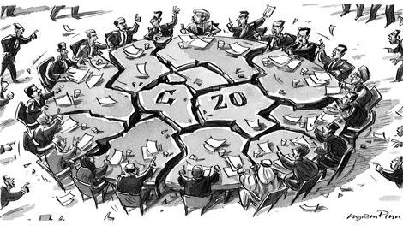
What could/did happen at Seoul?

Slide 67
China vs. the US?
Help your understanding: - rap http://behindthewall.msnbc.msn.com/_news/2010/11/11/5447670-chinas-in-the-house

